Slide 1
Neurodiversity & Networking: Breaking the Awkward Silence
Erissa Duvall

Slide 2

Ask questions!
I’m here to help you!
Erissa
Notes:
“Keep Calm and CYA” image was sourced from CYA is Killing Your Organization. I recently started working with an… | by Jennifer Cross | It's Your Turn (itsyourturnblog.com)
Image Source URL: https://itsyourturnblog.com/cya-is-killing-your-organization-c2a17e15d834
I’m here to help you!
I will also have links to resources at the end of the presentation.
So no worries about missing anything

Slide 3
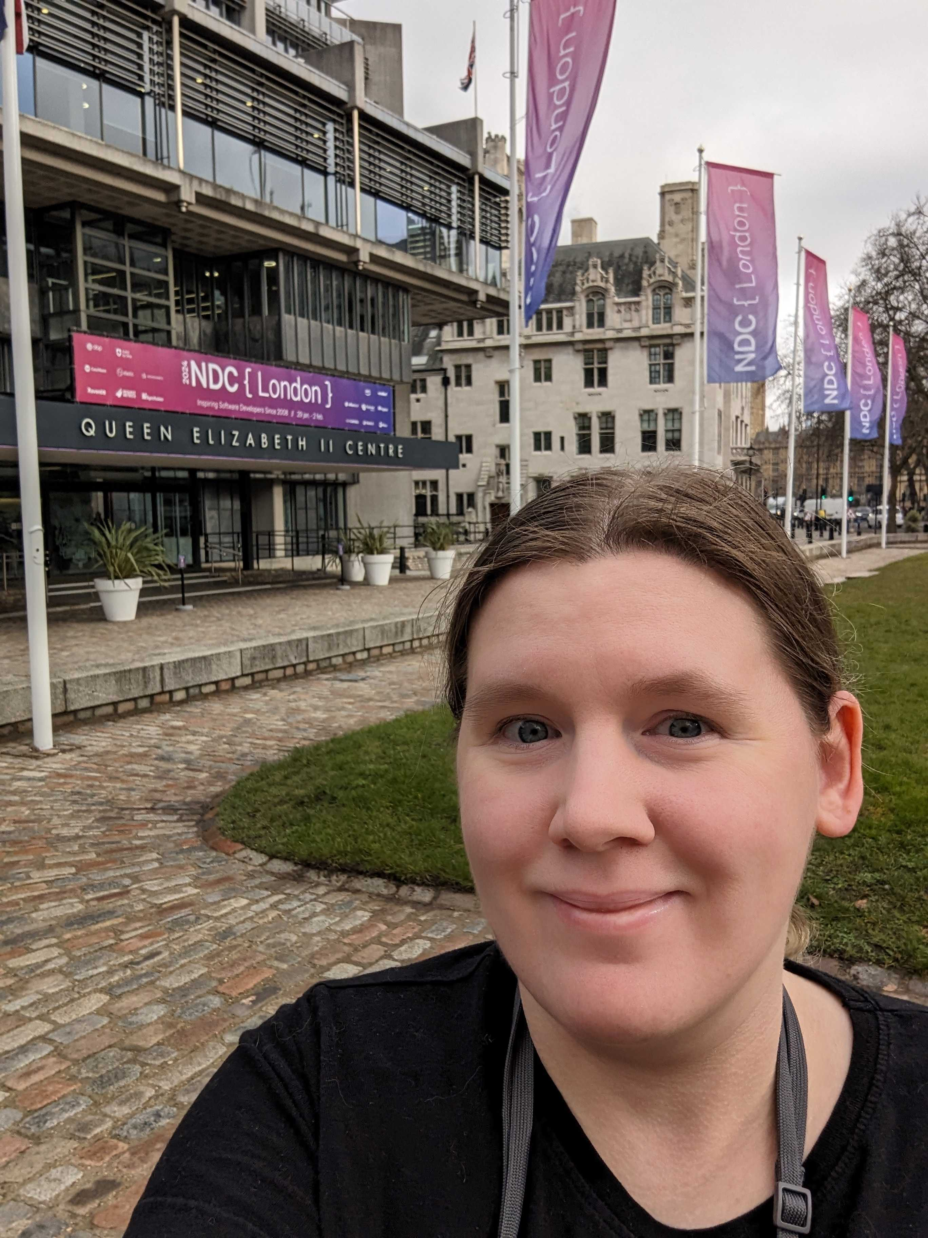




Slide 4

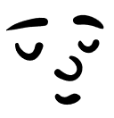
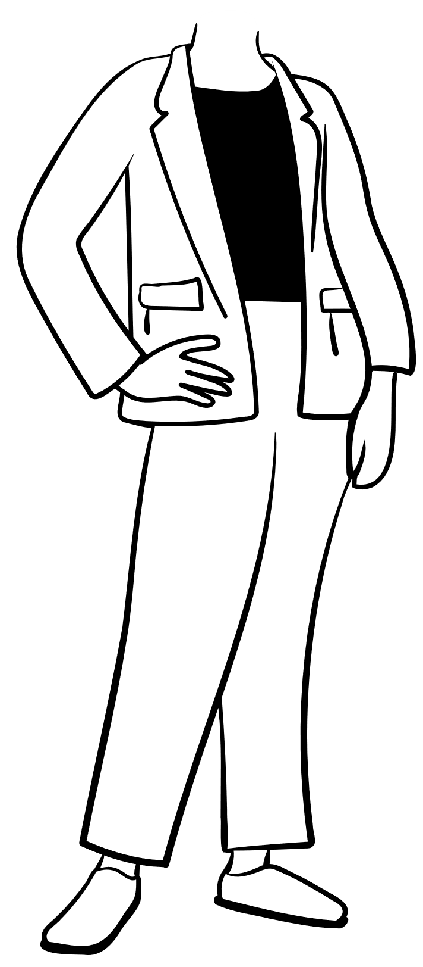

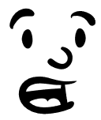
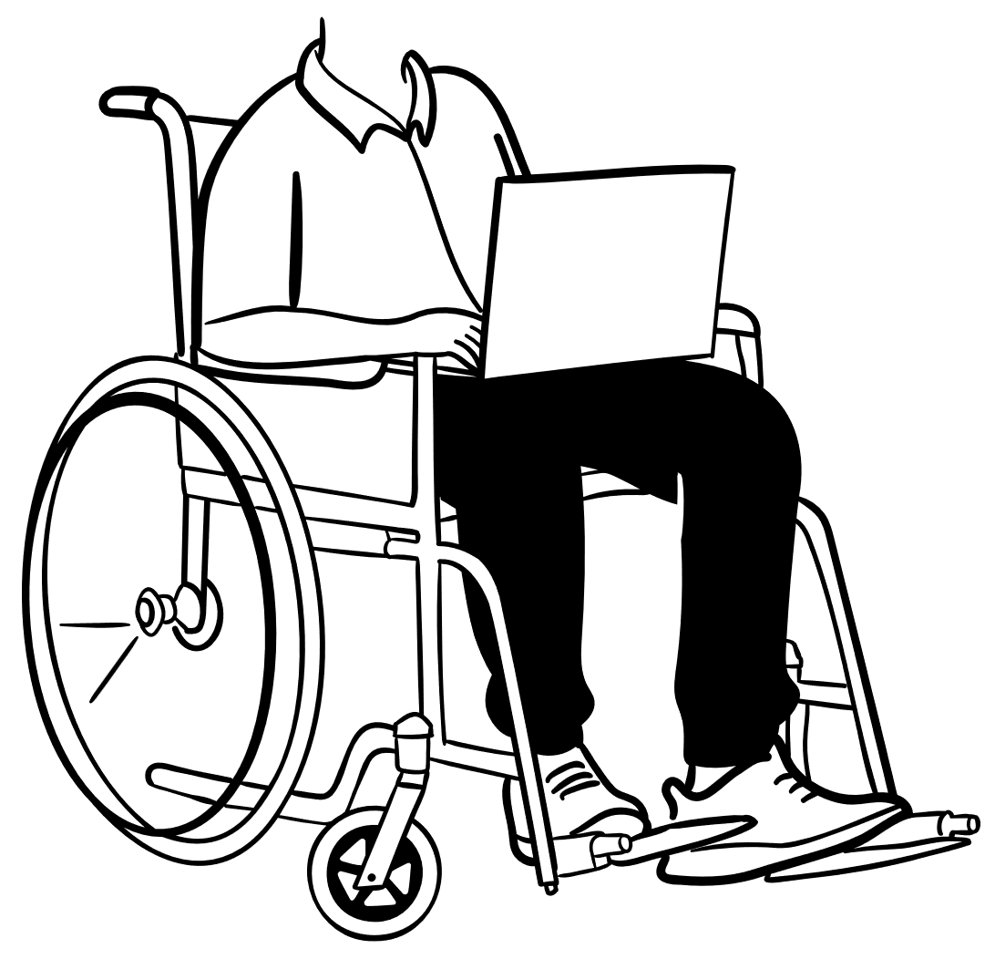
Networking
Erissa
Notes:
Neurodivergent is typically the word we see used when people are discussing someone on the autism spectrum, or whose brain just processes things differently from the norm.
But there in lies the problem. The term has a tendency to be used in a more negative connotation.
It is often used to say there is this baseline of what we consider “normal” and you deviate from that.
It is often used to make some people feel like they don’t fit in, and that they can’t unless they act like everyone else.

Slide 5
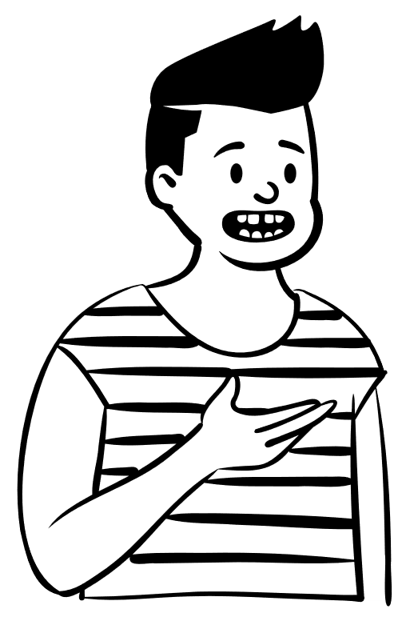
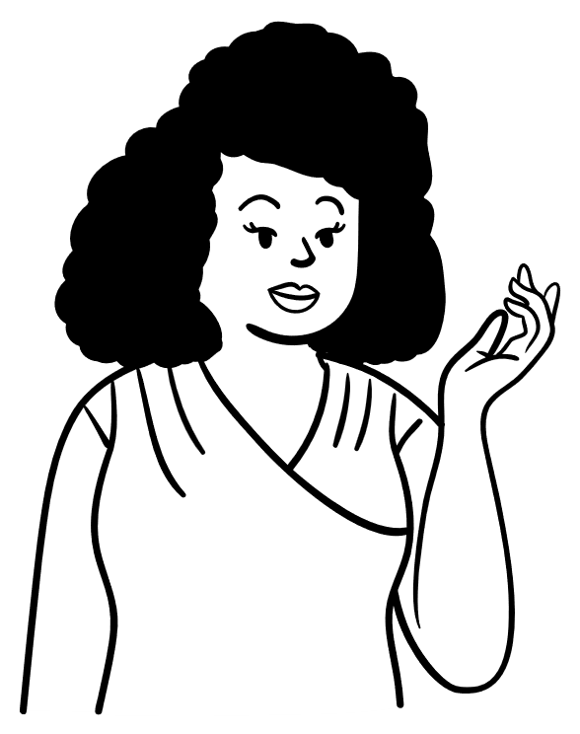
Networking
Erissa
Notes:
Neurodivergent is typically the word we see used when people are discussing someone on the autism spectrum, or whose brain just processes things differently from the norm.
But there in lies the problem. The term has a tendency to be used in a more negative connotation.
It is often used to say there is this baseline of what we consider “normal” and you deviate from that.
It is often used to make some people feel like they don’t fit in, and that they can’t unless they act like everyone else.

Slide 6

Networking Struggle
Networking
Me
Erissa
Notes:
Neurodivergent is typically the word we see used when people are discussing someone on the autism spectrum, or whose brain just processes things differently from the norm.
But there in lies the problem. The term has a tendency to be used in a more negative connotation.
It is often used to say there is this baseline of what we consider “normal” and you deviate from that.
It is often used to make some people feel like they don’t fit in, and that they can’t unless they act like everyone else.
Speaking to HR magazine Nicole Donne, consultant at charity Neurodiversity in Business, said: "Social finesse and networking can be like a game where the rulebook was handed to the other 80% of people in that room, and can navigate naturally.“ - https://www.hrmagazine.co.uk/content/news/networking-when-neurodivergent-could-be-made-easier/

Slide 7
Neurodivergent
Erissa
Notes:
Neurodivergent is typically the word we see used when people are discussing someone on the autism spectrum, or whose brain just processes things differently from the norm.
But there in lies the problem. The term tends to be used with more of a negative connotation.
It is often used to say there is this baseline of what we consider “normal” and you deviate from that.
It is often used to make some people feel like they don’t fit in, and that they can’t unless they act like everyone else.

Slide 8
Neurodiverse
Erissa
Notes:
That is why I prefer the term Neurodiverse, which refers more so the everyone because everyone is different in how they view the world around them.
Everyone has had different life experiences and their brains have developed different ways of processing information about what they see, hear, and experience in the world around them.

Slide 9

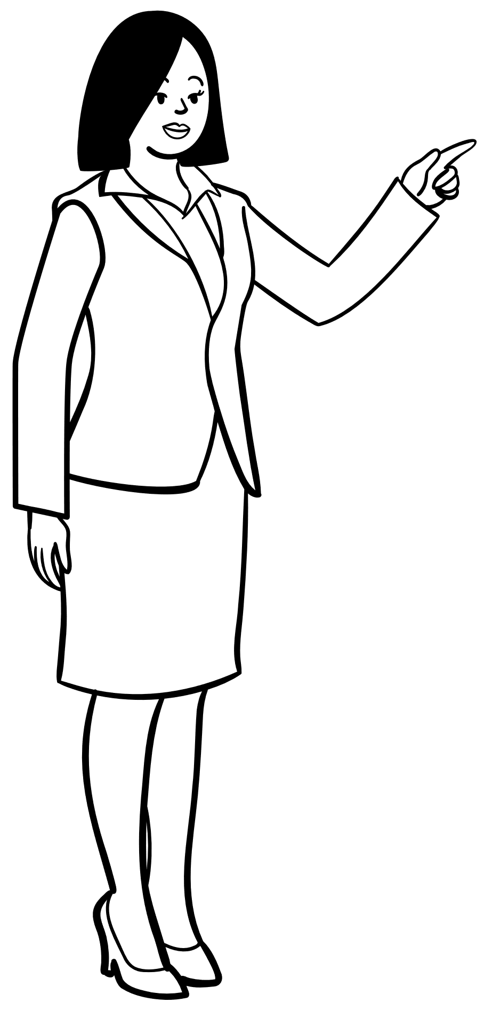
Role Models
Erissa
Notes:
From the time we are small kids we see people who are what we think is successful and want to be like them. We copy them.
This isn’t necessarily a bad thing as long as we don’t take it too far or forget something important.

Slide 10
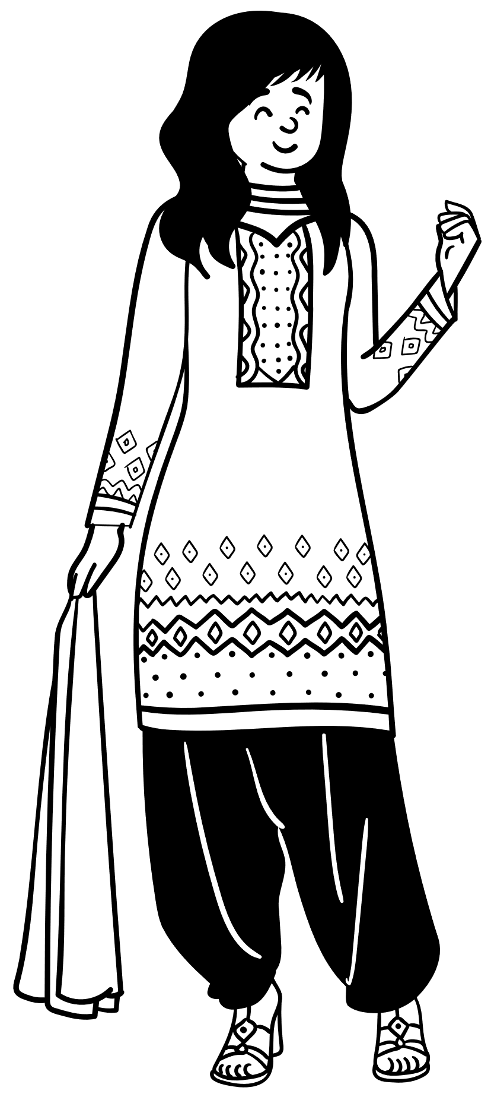
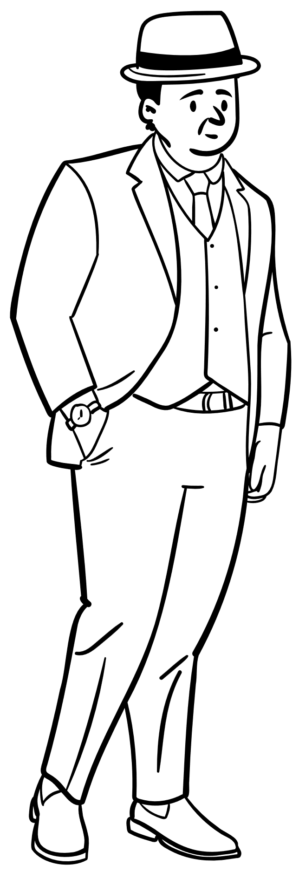

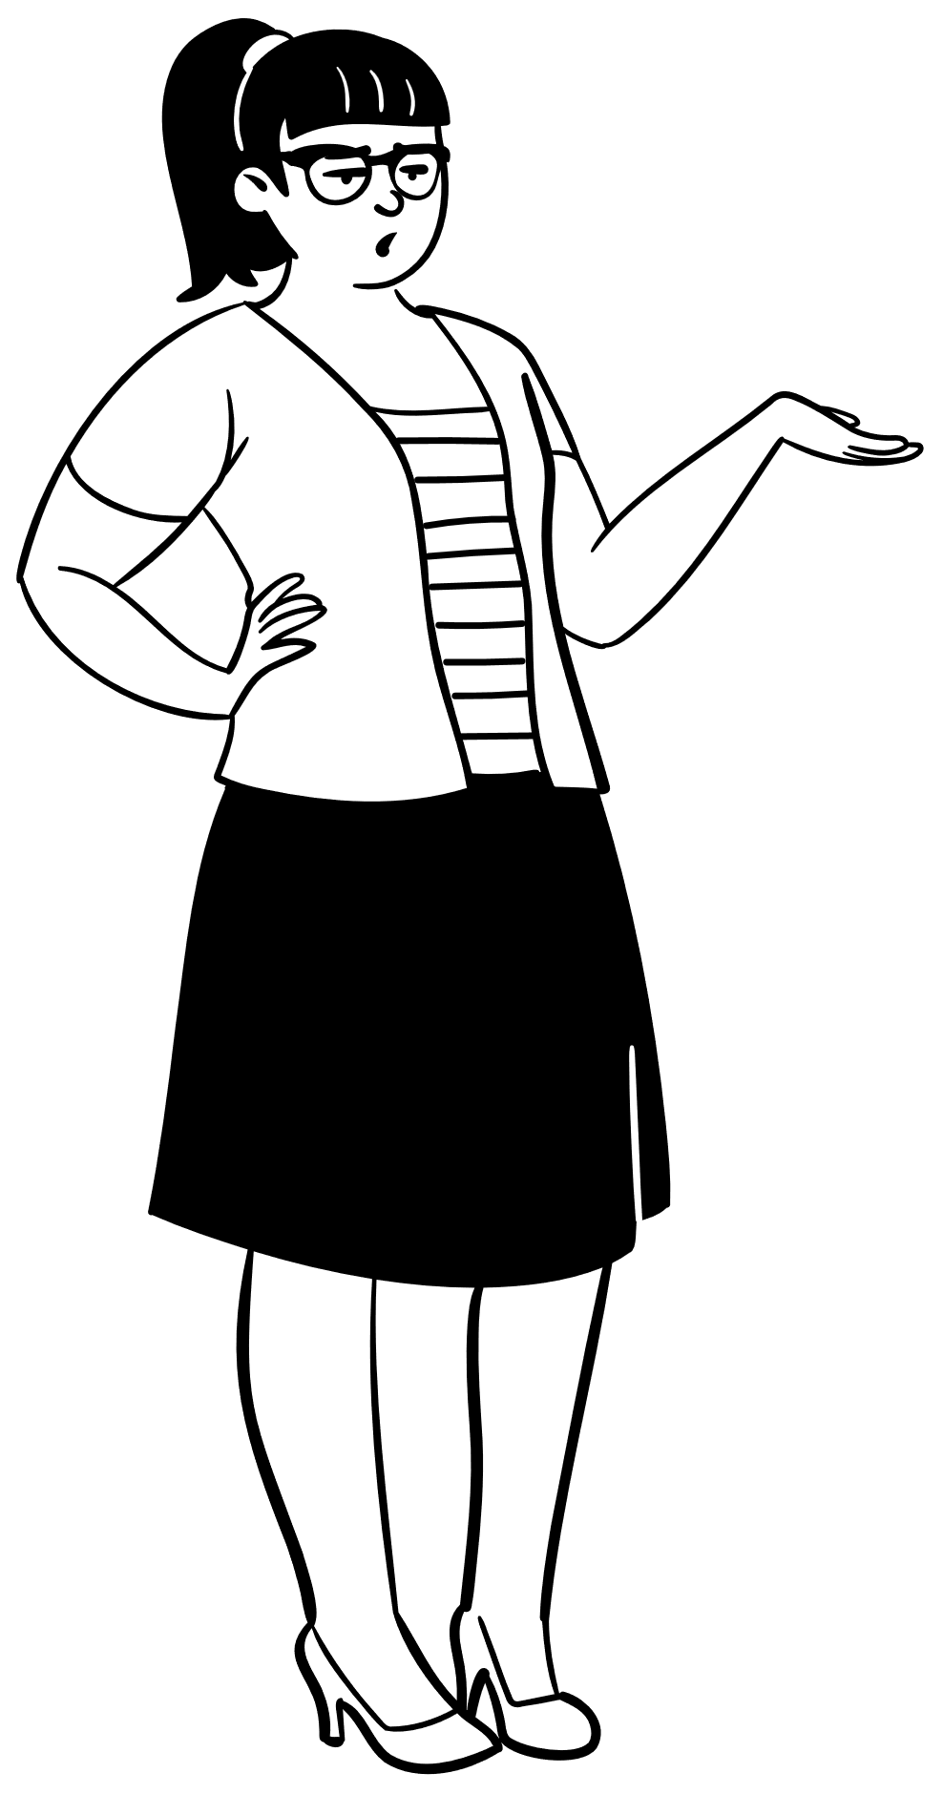

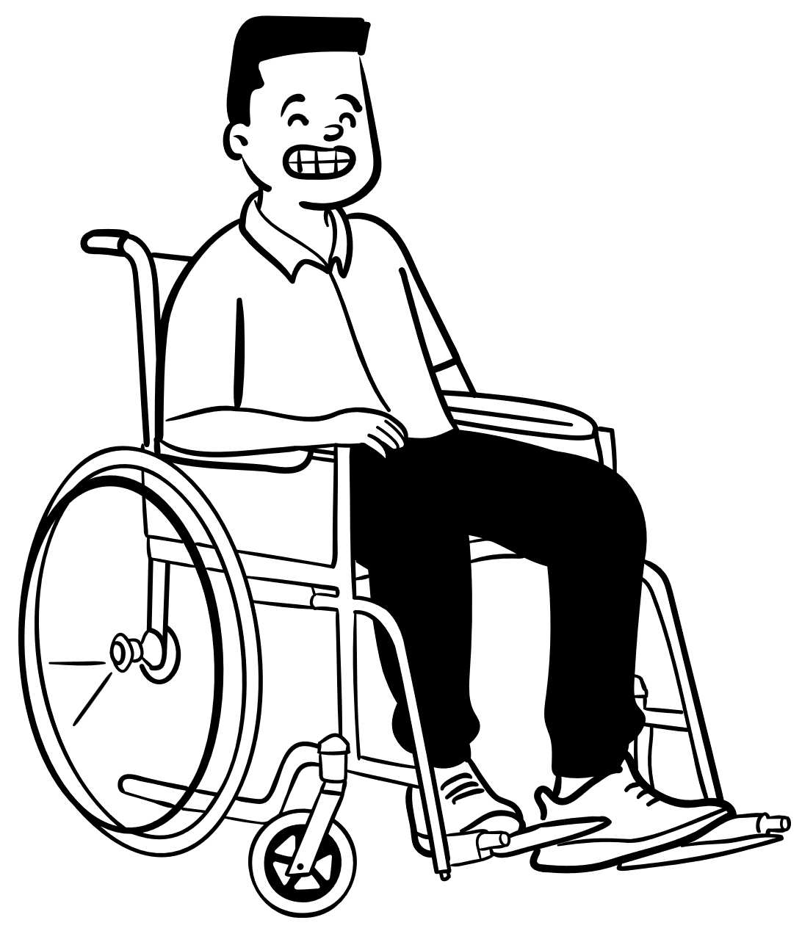
We aren’t all the same
Erissa
Notes:
We often get so caught up in trying to fit in and be like everyone else that we forget we aren’t all carbon copies of one another.
We all experience the world differently.
Have different lived experiences and ways our brains have developed to process the things around us that have shaped how we perceive and react to the world around us from minute to minute.
What works for one person doesn’t always work for the rest.
The way you are most productive isn’t necessarily the most productive method for someone else.
We get so caught up sometimes in trying to be like everyone else that we forget how to just be ourselves
Or even worse, we forget that it is okay to just be ourselves.
When we are trying to be someone else it is like being on alert every minute of the day.
If you ever worked retail, you’ve probably heard of the customer service voice.
You’ve probably felt the feeling of intense relief you get when you get home where you feel safe to drop the façade.
This is further emphasized in some school lessons when we learn things like public speaking in a particular way. Often lacking flexibility. There is a problem with that.
The following quote was on that site, but I couldn’t figure out exactly where it originated from. It is present on a lot of other sites, memes, etc. “Life is the most difficult exam. Many people fail because they try to copy others, not realizing that everyone has a different question paper.”

Slide 11
Be Inspired but Don’t Copy
“When adapting an existing idea, your goal is to get inspired by what the author accomplished and to use it to drive your own creative thinking – not to copy their approach exactly.”
Erissa
Notes:
Be inspired but don’t just copy.
The quote on this slide is by Chuck Frey on his Catalyst Newsletter

Slide 12
Don’t Rush
Erissa

Slide 13
Be Kind to Yourself
Erissa

Slide 14
Find the Right Environment
Talk to the organizer
Try different events
Identify aspects you like / dislike
Erissa

Slide 15
Going to an Event
Create a time buffer
Go with someone you know
Don’t feel required to stay
Ask questions
Control what you can
Erissa

Slide 16
Resources
HR Magazine - Networking when neurodivergent could be made easier
Challenges of networking and neurodiversity – Drive, the Collaborative Network
Fork theory: A multi-pronged approach to support neurodivergent networking - CareerWise
Erissa

Slide 17
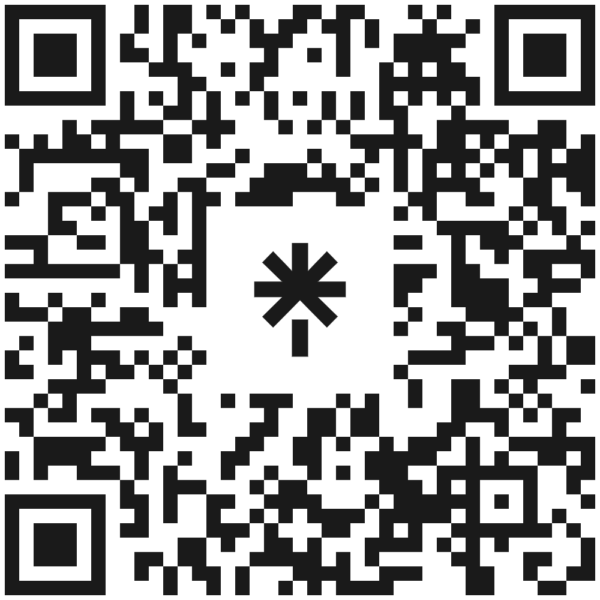
Thank you!
Erissa Duvall
www.Corgidev.com
linktr.ee/corgidev
Erissa

